Slide 1

AI and Automation in Full Stack Web Development
Presenters:
Utkarsh
Prince Kumar
Shivam Kumar
University:
Lovely Professional University

Slide 2
Introduction
Traditional full stack development = time-consuming + repetitive
AI introduces: automation, intelligence, personalization
"Traditional web development involves a lot of manual steps. But with AI, we can now automate coding, testing, deployment, monitoring, and more."

Slide 3
Problem Statement
Manual development slows down the cycle
Repetitive code writing, manual testing = low productivity
"This invention addresses the common issues of time consumption
and inefficiency in full stack development.”

Slide 4
Objectives
Integrate AI into legacy full stack environments
Improve scalability, efficiency, and consistency
Enable real-time monitoring and smart deployment
“Our aim is to modernize the development pipeline using smart tools that enhance both performance and user experience.”

Slide 5
Novelty & Research Gap
Existing tools focus on backend or IDE assistance only
Our system covers full stack: UI, backend, CI/CD, testing, monitoring
“Unlike other approaches that focus only on pieces of the stack, our invention automates and enhances the entire lifecycle.”

Slide 6
Core Architecture
Full Stack Intelligence Framework
Backend Automation Core
Frontend AI Engine
Smart Database Layer
CI/CD Automation
AI Testing Suite
Monitoring & Optimization Module
“Each of these modules is powered by AI and they communicate via APIs to deliver seamless automation.”

Slide 7
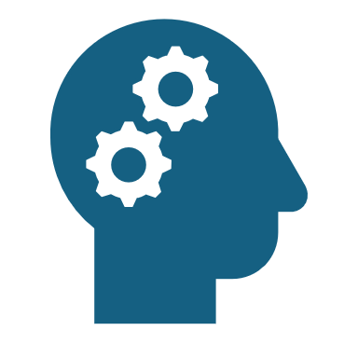
AI Techniques Used
NLP for converting natural language to code
Code Generative Models for logic blocks
Multi-task & Reinforcement Learning
Chaotic Pattern Analysis for bug detection
“AI models are trained to handle multiple development tasks and adapt over time based on feedback and usage.”

Slide 8
Automated CI/CD & Testing
AI writes test cases
Simulates and deploys code based on risk & traffic
Automatic rollback on failure
“I makes decisions like a smart developer — when to go live, when to hold, and when to fix issues.”

Slide 9
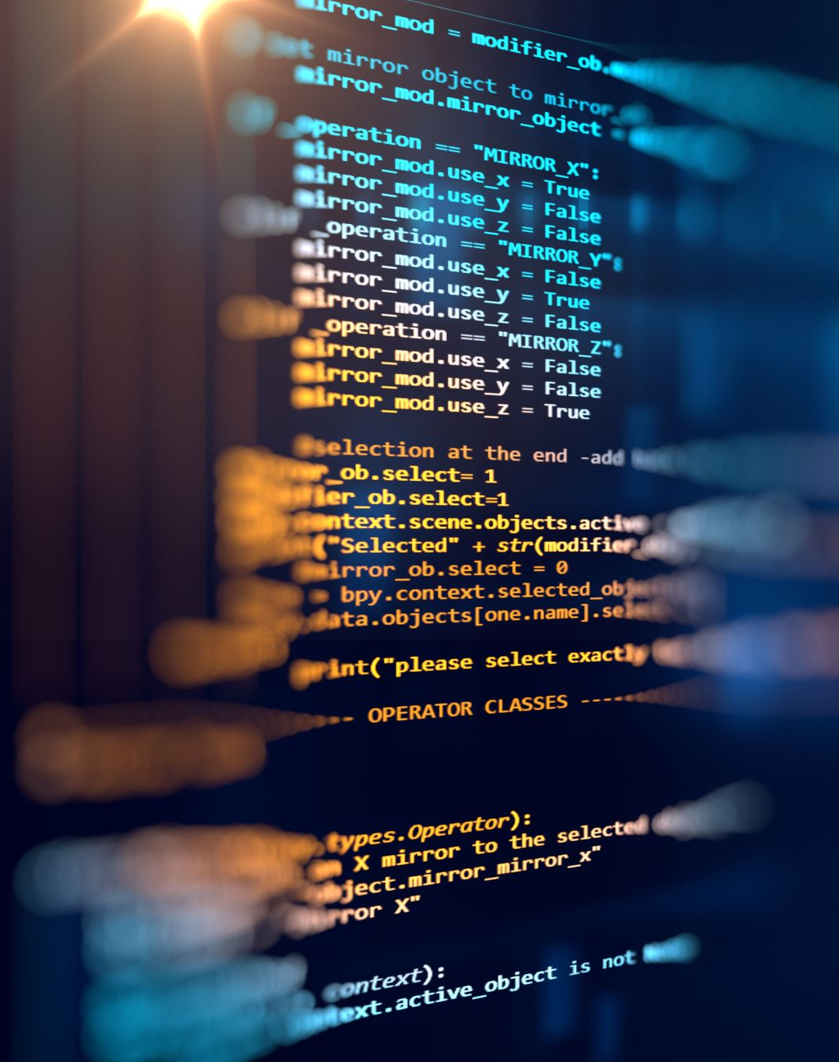
Real-Time Monitoring & UX Personalization
Monitors server usage, error logs
UI personalization based on behavior (e.g., device, clicks)
Predictive scaling
“AI can adapt the UI based on user behavior and make sure the app is always optimized.”

Slide 10

Security Framework
Anomaly detection & behavioral access control
Adaptive security protocols
“Security is dynamic – it adapts based on user context, making the system more robust and secure."

Slide 11
Key Benefits
Faster development
Natural language to code conversion
Backend optimization
End-to-end testing & deployment
Real-time analytics
AI-driven security
"These benefits improve both developer productivity and user experience."

Slide 12
Industry Relevance & Companies
Potential Collaborators:
GitHub (Copilot)
JetBrains (IntelliJ, WebStorm)
Atlassian (Jira, Bitbucket)
"These industry leaders can help scale our system to reach professional development environments."

Slide 13

Current Status & Future Work
Prototype: In progress (1 year timeline)
Next steps: Build working modules, test performance, approach collaborators
“We’re laying the groundwork now, and the goal is a fully working intelligent development platform in the near future.

Slide 14
Conclusion
“AI and automation aren't just trends—they're the future of software development. This project shows how we can bring intelligence, speed, and adaptability to the full development stack. Thank you!"

